Slide 1
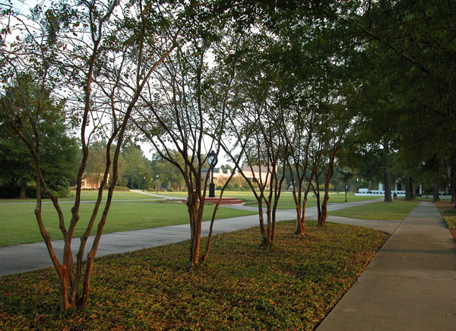
FRANCIS MARION UNIVERSITY
August 2017
Introduction of Colleague Finance and Patriot Portal for End-Users

Slide 2
New System, New Features
Less Paper:
Electronic Requisitions
Electronic Signatures
Electronic Receiving Approvals
Budget Reports on Demand
Report Query Structure
Paper still required for travel reimbursements
New accounting code structure
2

Slide 3
Chart of Accounts Changes
Old -> 1-035-E4100-0000 = General Fund, Fine Arts, Supplies
New -> 100000-12203-82000 = General Fund, Fine Arts, Supplies
Fund - Department - Object
3

Slide 4
So Why Did we Change the Code?
Codes can no longer be deleted and reused.
Fund Code
We consolidated the fund and smallest fund break down while adding another digit.
Department Code
In order to provide better roll-up reporting by division, schools, and major departments, we added two digits to the sequence.
Object Code
No more alpha digit! Sorry for those that liked it.
The new Chart of Accounts and further explanation of our code structure can be found at http://www.fmarion.edu/financialservices/erp/
4

Slide 5
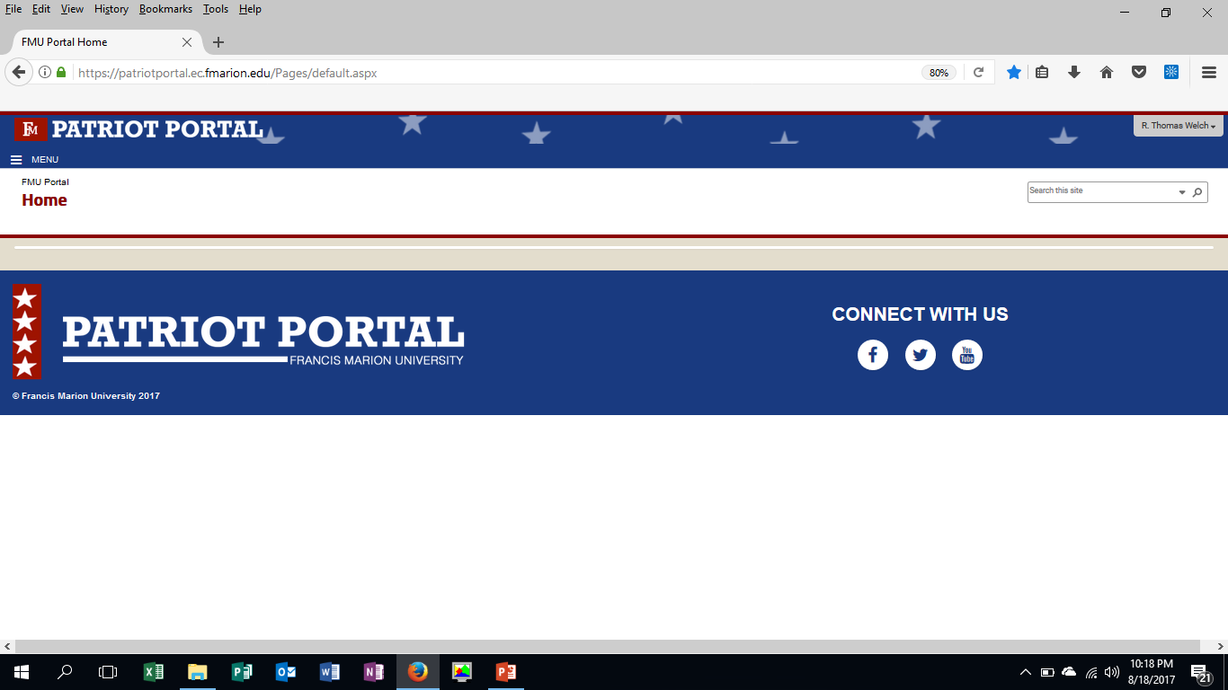
Your Access to Colleague
Meet Patriot Portal!
http://www.fmarion.edu/financialservices/erp/
Once Logged in, click the menu.
5

Slide 6
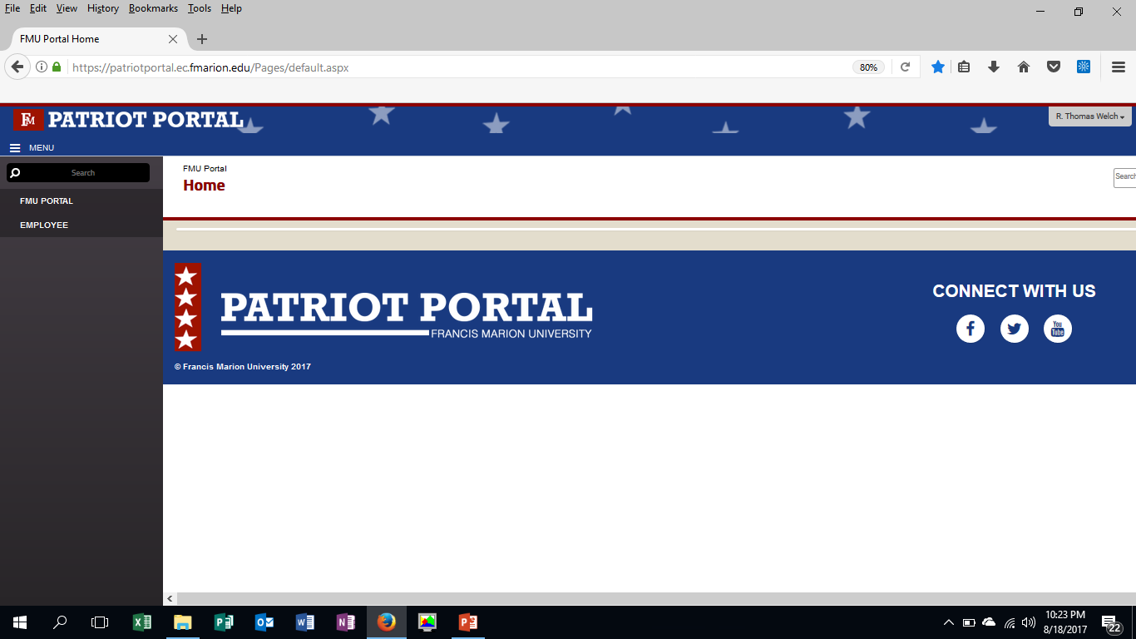
Accessing Your First Screen
Click the Employee Option.
6

Slide 7
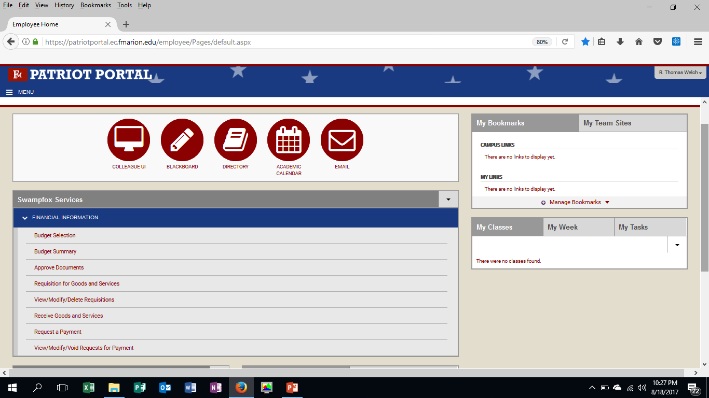
Your Options with Colleague Finance
Use this to query your budget anywhere, anytime in real time.
Use this to recall your last budget selection setup instantly.
Account administrators can approve requisitions electronically.
Requisition goods and services.
Report the receipt of goods and services.
Request a PTI, pay an invoice, or request reimbursement (non-travel).
7

Slide 8
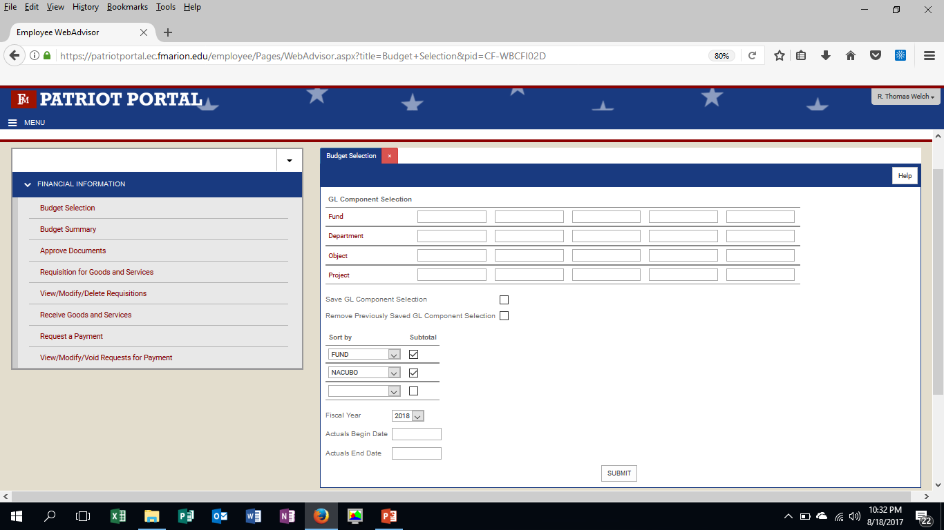
Budget Selection & Budget Summary
Look up an account by entire code, or a single GL component.
Save your current search if you like it.
Decide how you want it sorted and totaled.
Pick your year or your period you want to review.
8

Slide 9
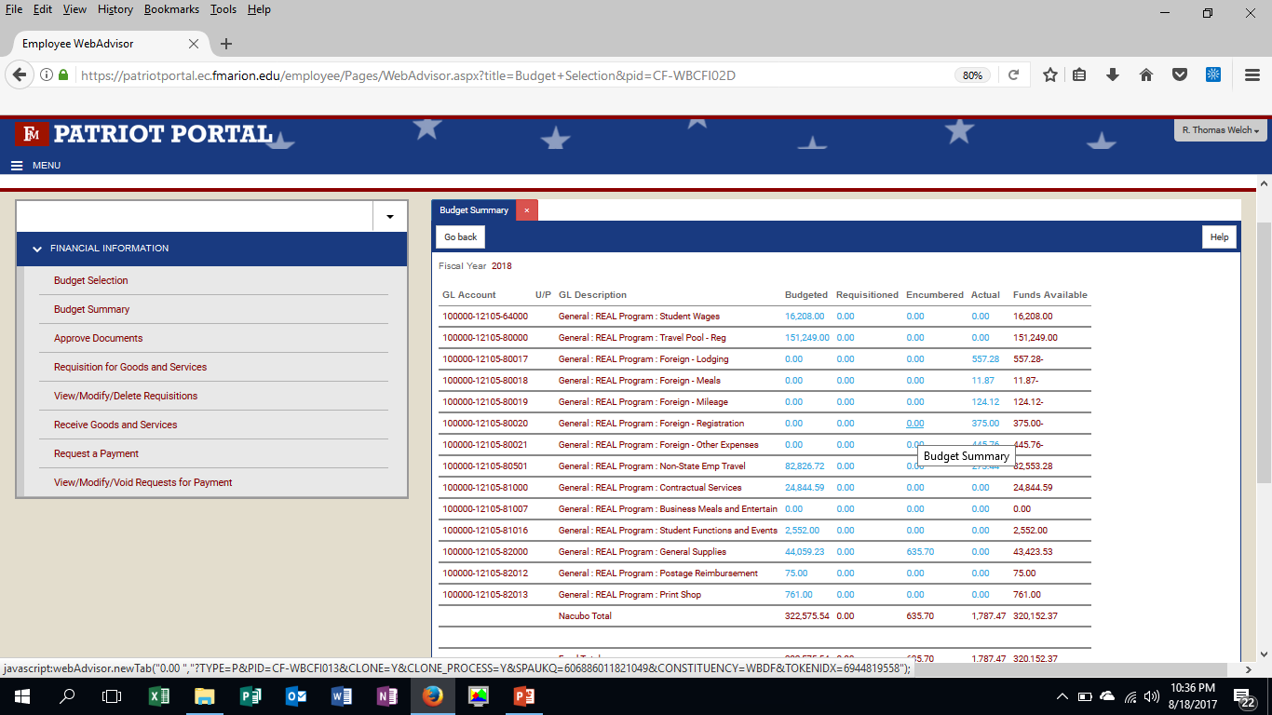
Budget Selection & Budget Summary
You can drill down into the blue cells for detail of activity all the way to the transaction detail.
9

Slide 10
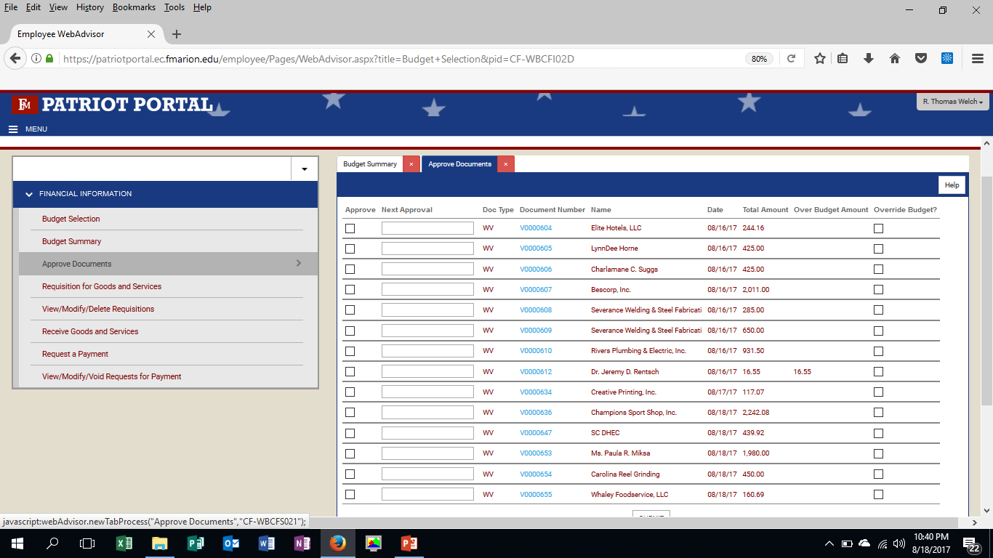
Approval of Documents (Account Disbursement Approvers Only)
One click transaction approval. No more chasing signatures!!!
Approve override of over budget accounts.
Click to view the transaction information before approval.
10

Slide 11
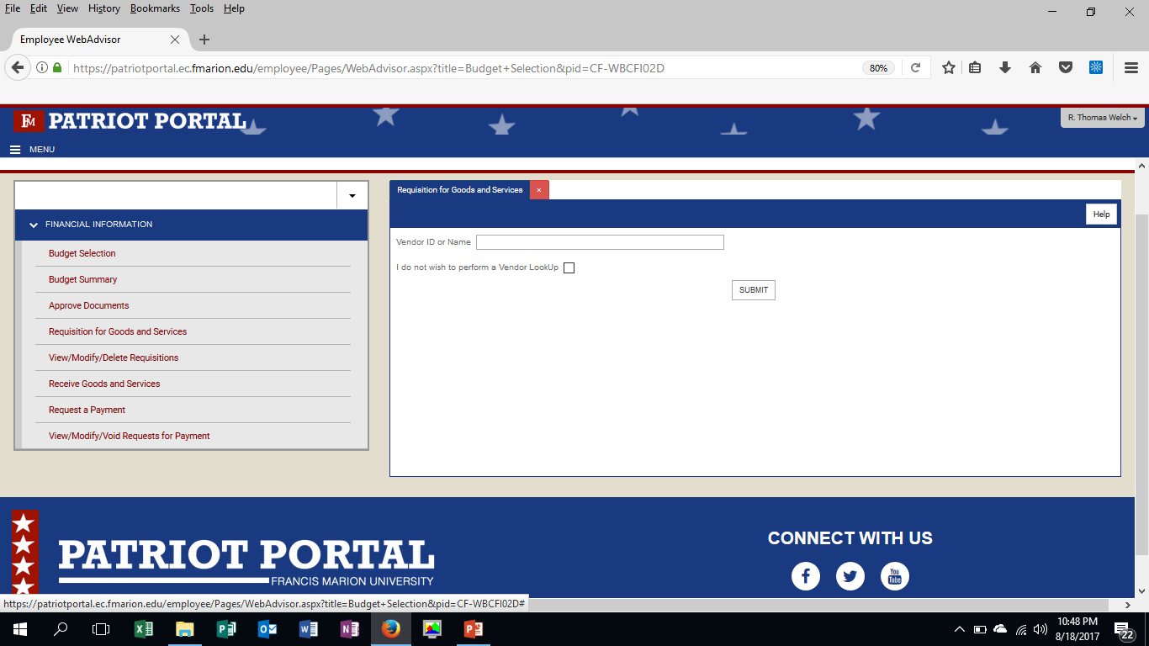
Requisition for Goods and Services
Step 1: Vendor Lookup
Three Options:
Select an existing vendor
Do not assign a vendor and let Purchasing find the right vendor.
If you have a new vendor, contact Purchasing to set the new vendor up.
Find the new vendor setup form at http://www.fmarion.edu/financialservices/erp/
11

Slide 12
Requisition for Goods and Services
Step 2: Vendor Selection
12

Slide 13
Requisition for Goods and Services
STEP 3: Requisition Completion and Submission (Part 1)
Automatically provided
Select the correct shipping address*
Select the desired date
Should always be “AP Standard AP”
Select the object code that best fits the item.
Enter a 30 character description.
If you know a vendor item number
Cost center is the fund and department number
If the account has a project code provide it.
13
* - See shipping codes listing at http://www.fmarion.edu/financialservices/erp/

Slide 14
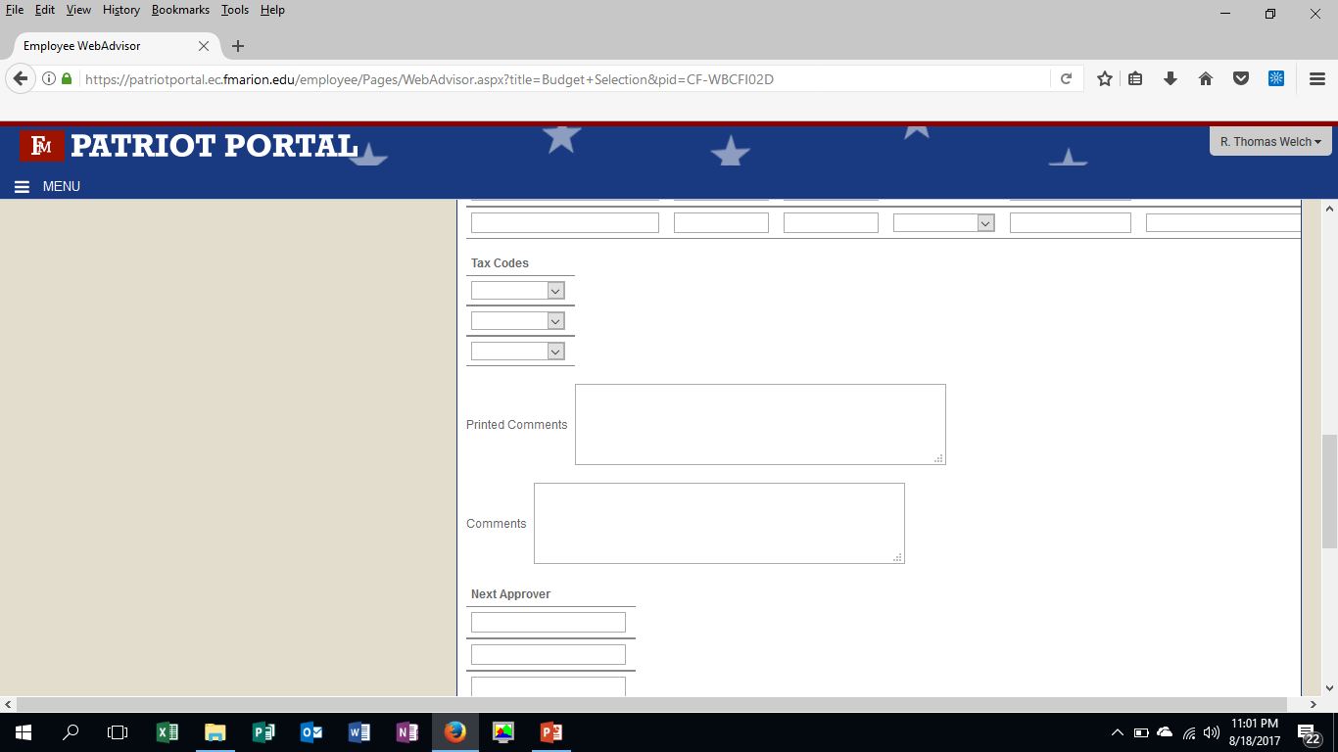
Requisition for Goods and Services
STEP 3: Requisition Completion and Submission (Part 2)
Do not fill this section out.
If you have printed comments for the vendor enter them here.
If you have comments for Purchasing enter them here.
Approvers will auto populate based on accounts used for the purchase.
Don’t forget to submit!
14

Slide 15
Receiving Goods and Services
Select the vendor or enter the purchase order you are receiving goods or services for.
Accepting all is not advised.
Enter this information from the packing slip
Note any MSDS sheets received.
Enter the quantity accepted and rejected.
15

Slide 16
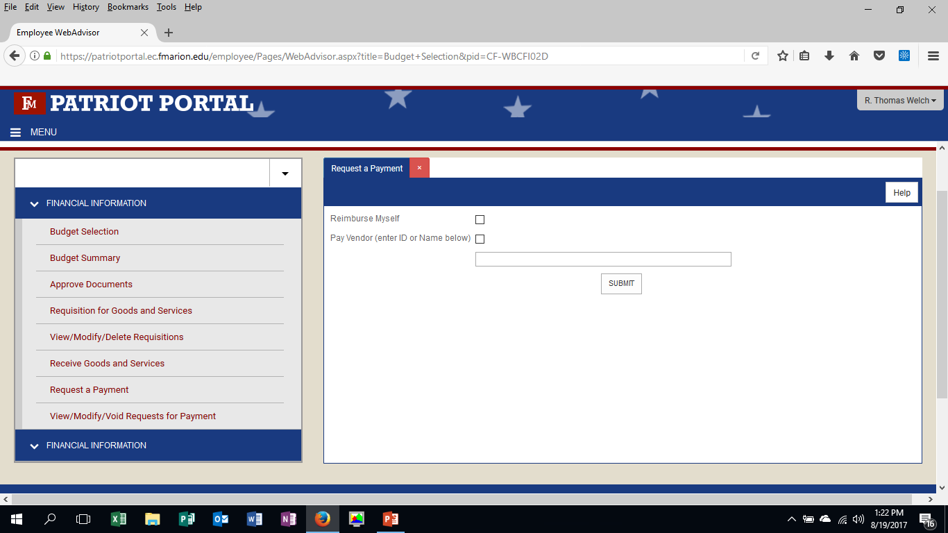
Request for Payment
Step 1: Who do we need to pay?
Request reimbursement
Pay a vendor
Search for a vendor name
16

Slide 17
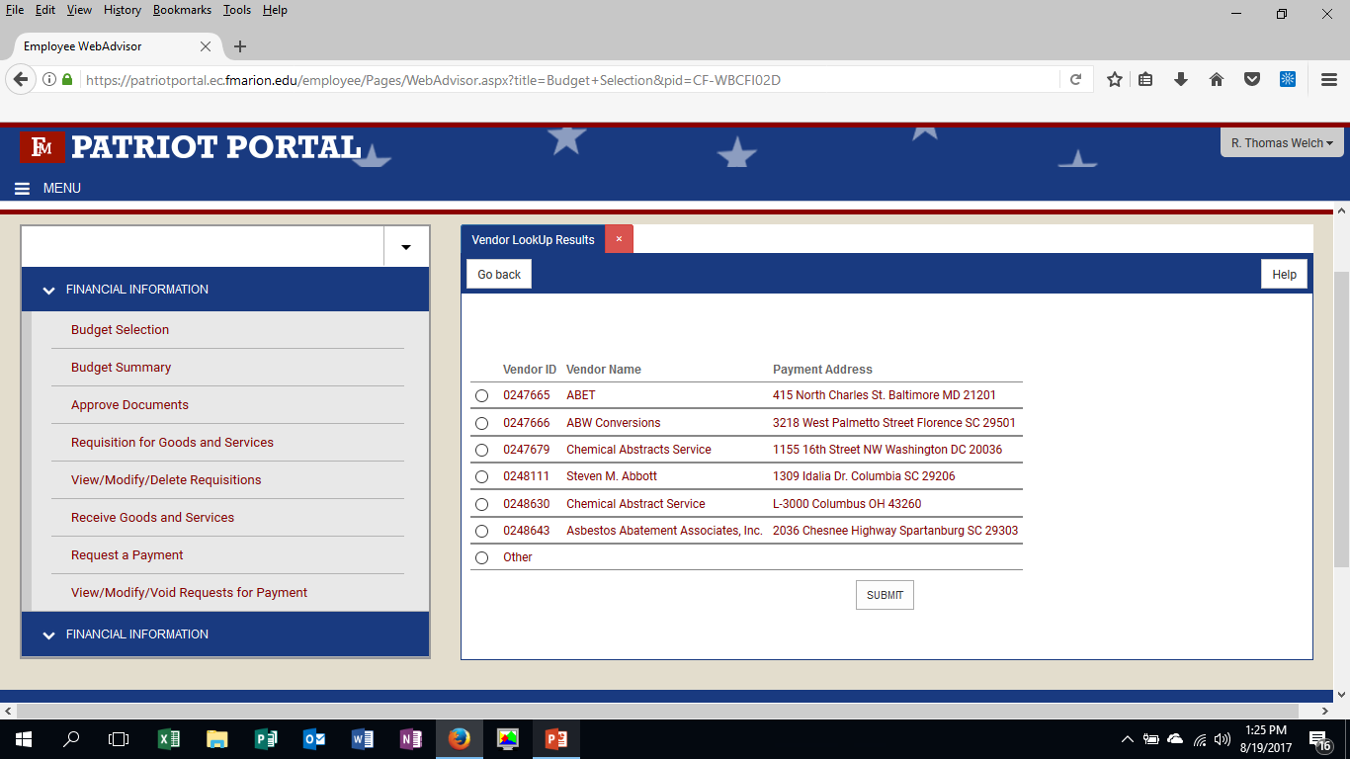
Request for Payment
Step 2: Select a Vendor
Pay a vendor we have on file.
Pay a vendor we don’t have on file.
REMEMBER: Contact Purchasing for instructions on creating a new vendor.
17

Slide 18
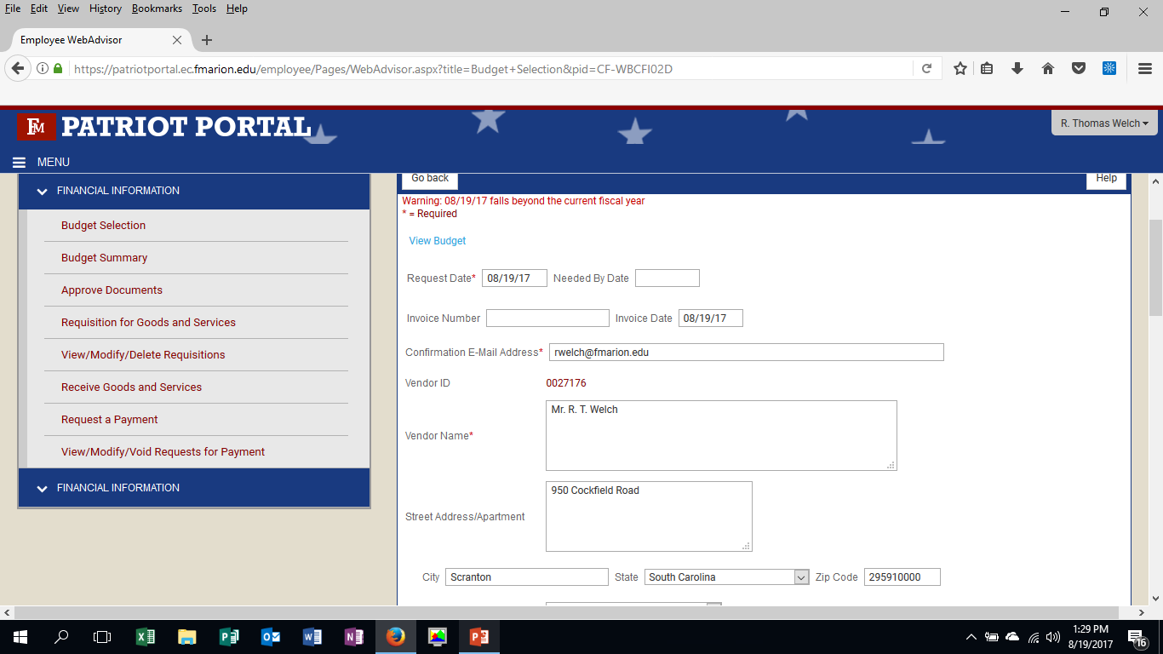
Request for Payment
Step 3a: Requisition Preparation
Automatically provided
Select the desired date for payment
If you received an invoice from the vendor provide the invoice number.
For vendors on file this will automatically populate. For new vendors, you will have to provide this information.
18

Slide 19
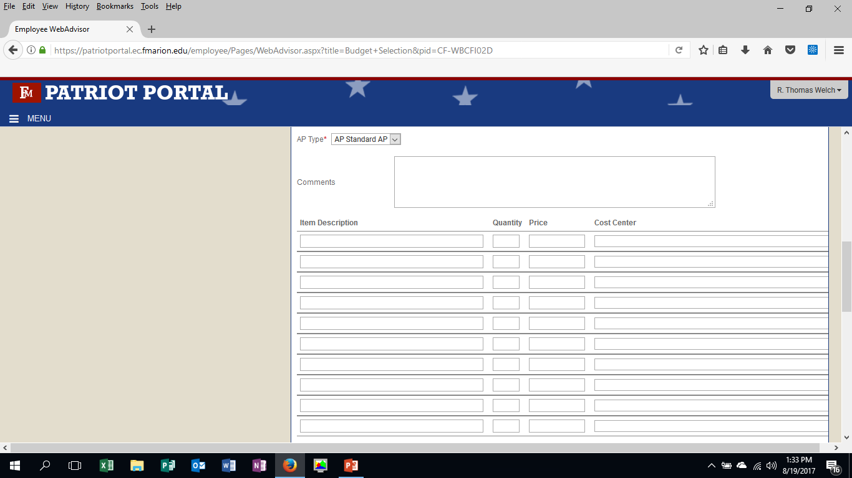
Request for Payment
Step 3b: Requisition Preparation Continued
Should always be “AP Standard AP”
If you have comments for Purchasing enter them here.
Enter a 30 character description.
Cost center is the fund and department number
Select the object code that best fits the item.
If the account has a project code provide it.
19

Slide 20
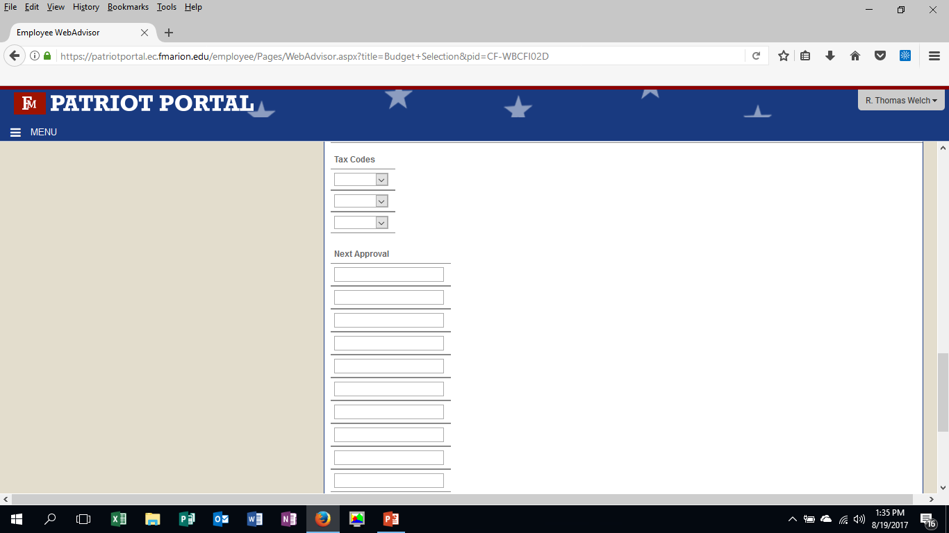
Request for Payment
Step 3c: Requisition Preparation Continued
Do not fill this section out.
Approvers will auto populate based on accounts used for the purchase.
Don’t forget to submit!
20

Slide 21
Links to FMU Business Affairs Resources
See all ERP related training materials, forms, and other resources at http://www.fmarion.edu/financialservices/erp/
Questions: Thomas Welch - rwelch@fmarion.edu
21

