Slide 1
FRANCIS MARION UNIVERSITY
February 2018
Introduction of Self-Service Financial Management

Slide 2
Same System, New Web Viewer
The Patriot Portal currently runs financial transactions through a features called Webadvisor.
Colleague is slowly replacing Webadvisor by Self-Service.
While Self-Service is not integrated in the Patriot Portal, we hope to one day be able to have such integrated into the Portal.
Self-Service offers easier to view budget reports and offers project reporting (unavailable through Webadvisor).
2

Slide 3
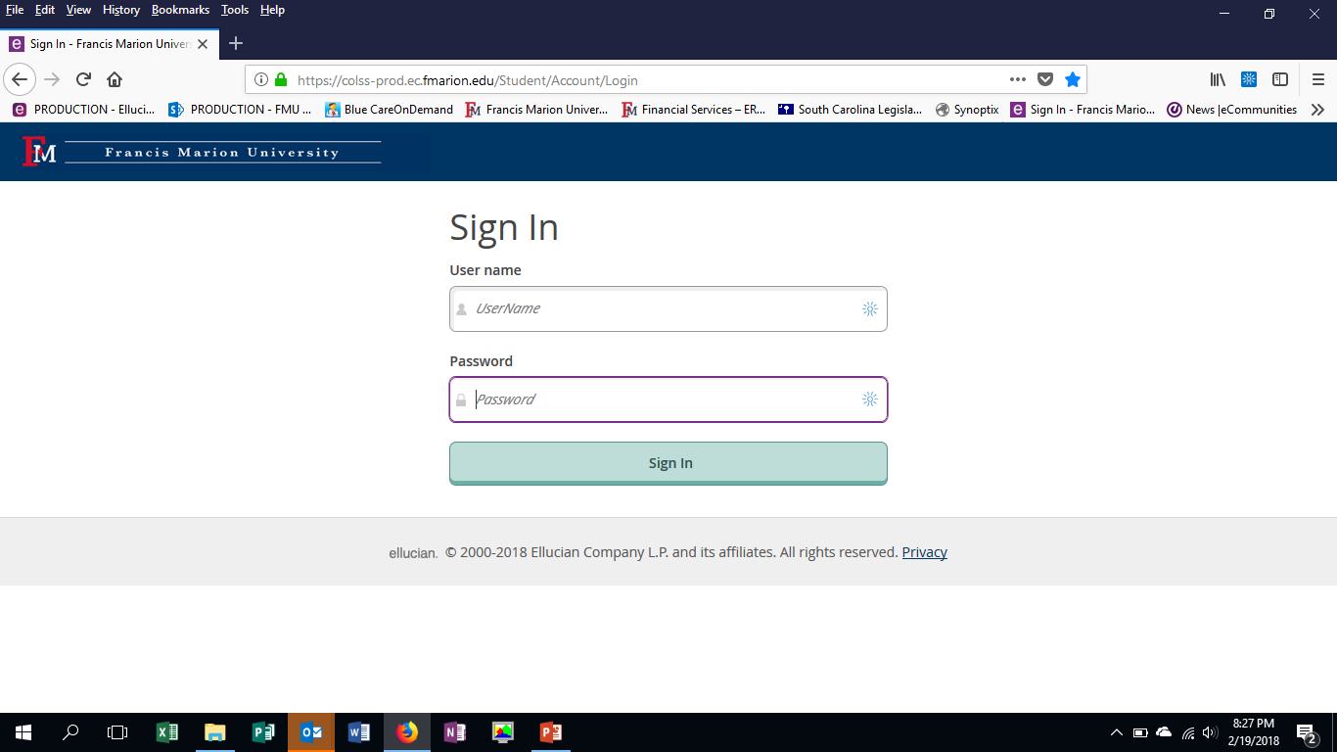
User Login
Your login credentials are the same as your single sign on for your email and computer.
3
The Link to Self-Service is available at: http://www.fmarion.edu/financialservices/erp/

Slide 4
Welcome to Self-Service!
To access your budget and project financial reports click on Financial Management.
Employee Self-Service and Student Self-Service is currently a single environment (website). FMU will eventually split these environments for ease of use.
4

Slide 5
Budget Management
Budget offers the same reporting as Budget Summary and Budget Selection in the Patriot Portal, but offers it with an easier quick view setup with the same drill down to transaction detail functionality provided by the Portal.
5

Slide 6
Views, Report Periods & Exporting
You can view budgets by cost center (fund + Department) or by object type (I.E. supplies, travel, etc.)
You can change your view from bar graph to list format.
You can look at a specific time period.
Export your information to excel!
6

Slide 7
Filters and Budget Descriptions
Your budgets will be displayed as easy to understand cost centers with the department number on the left side of the description. Click (drill down) on the account you want to review in detail.
If you want to filter to only see a certain account or range of accounts you can set filters to suit your need.
7

Slide 8
Drill Down into a Cost Center
Drill down into a cost center provides the same detail transactional detail as seen in Patriot Portal under Budget Selection and Budget Summary.
8

Slide 9
Projects Accounting
Projects Accounting can only be viewed in Self-Service. Webadvisor features currently in the Patriot Portal do not support budget review for project related accounts like professional development, REAL, some grants accounts, and other programs administered via projects by FMU.
9

Slide 10
Views, Report Periods & Exporting
While filters are available currently they are not necessary. In future years they may be used to see only active and open projects.
You can change your view from bar graph to list format.
Your budgets will be displayed as easy to understand project name with the project number on the left side of the description. Click (drill down) on the account you want to review in detail.
Export your information to excel!
10

Slide 11
Drill Down into a Project
Drill down into a project provides the same detail transactional detail as seen in budget management for cost centers.
Export your information to excel!
You can look at a specific time period.
11

Slide 12
Links to FMU Business Affairs Resources
See all ERP related training materials, forms, and other resources at http://www.fmarion.edu/financialservices/erp/
Questions: Thomas Welch - rwelch@fmarion.edu
12

