Slide 1
Purchasing LiveText
Please review each slide to ensure your account is created correctly.

Slide 2
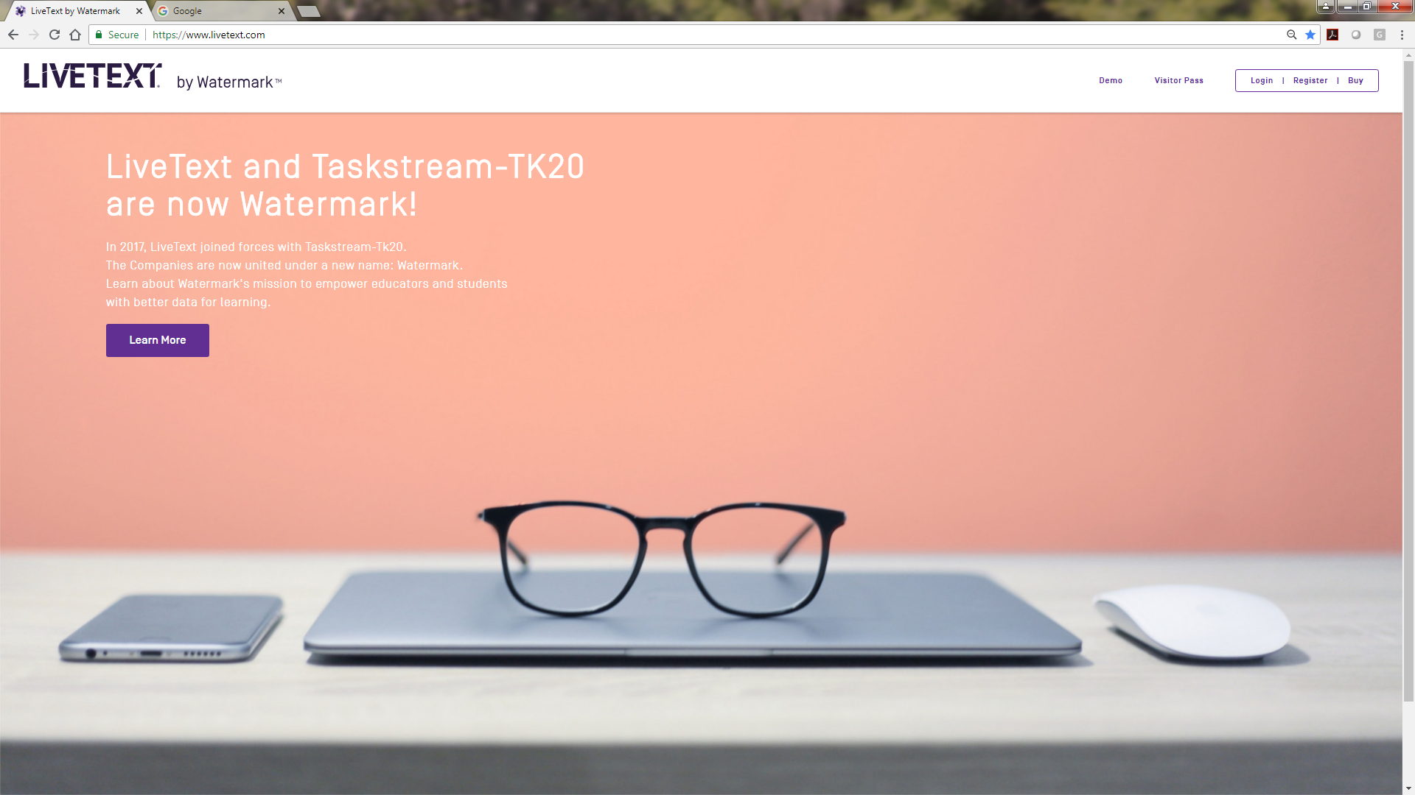
Select “Buy” in the top right corner

Slide 3
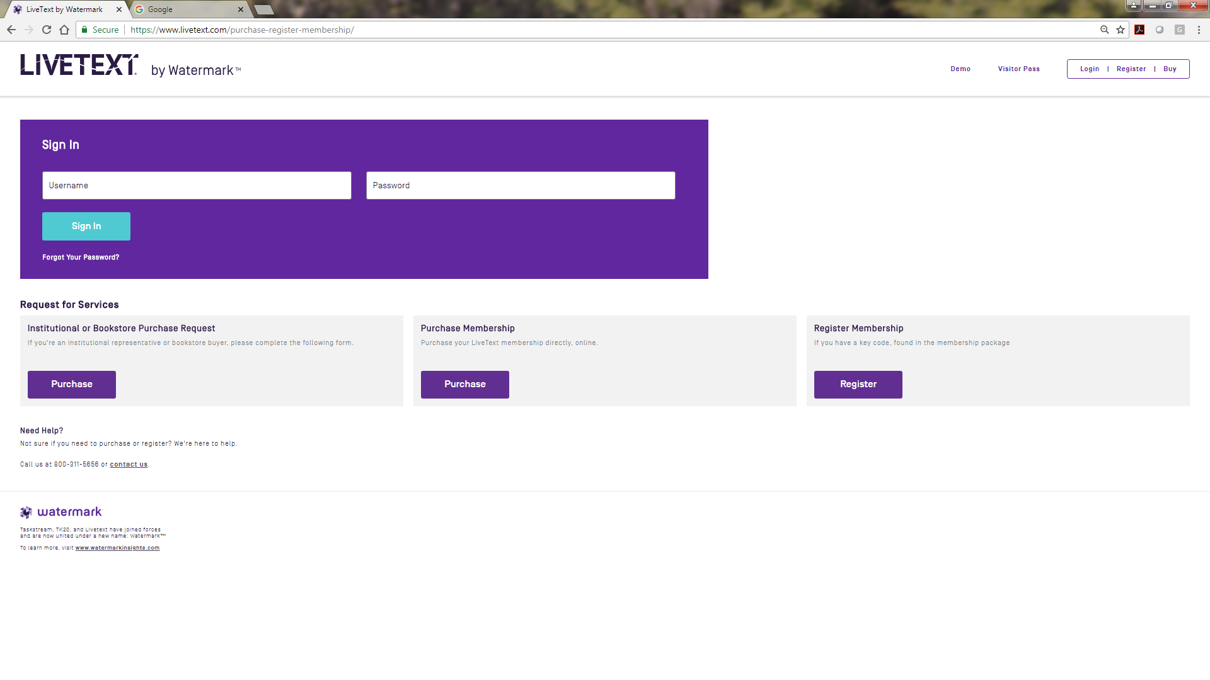
Select Purchase Membership

Slide 4
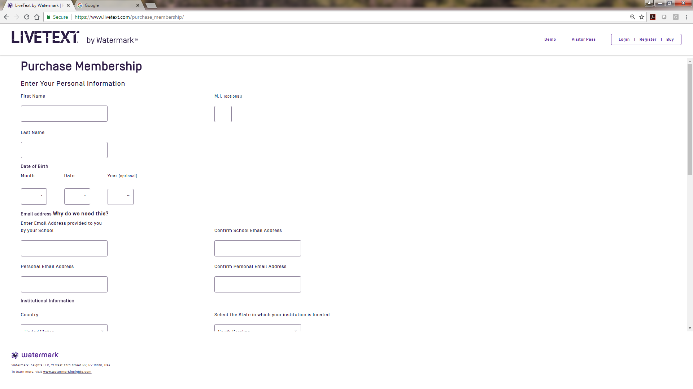
Enter Your Personal Information

Slide 5
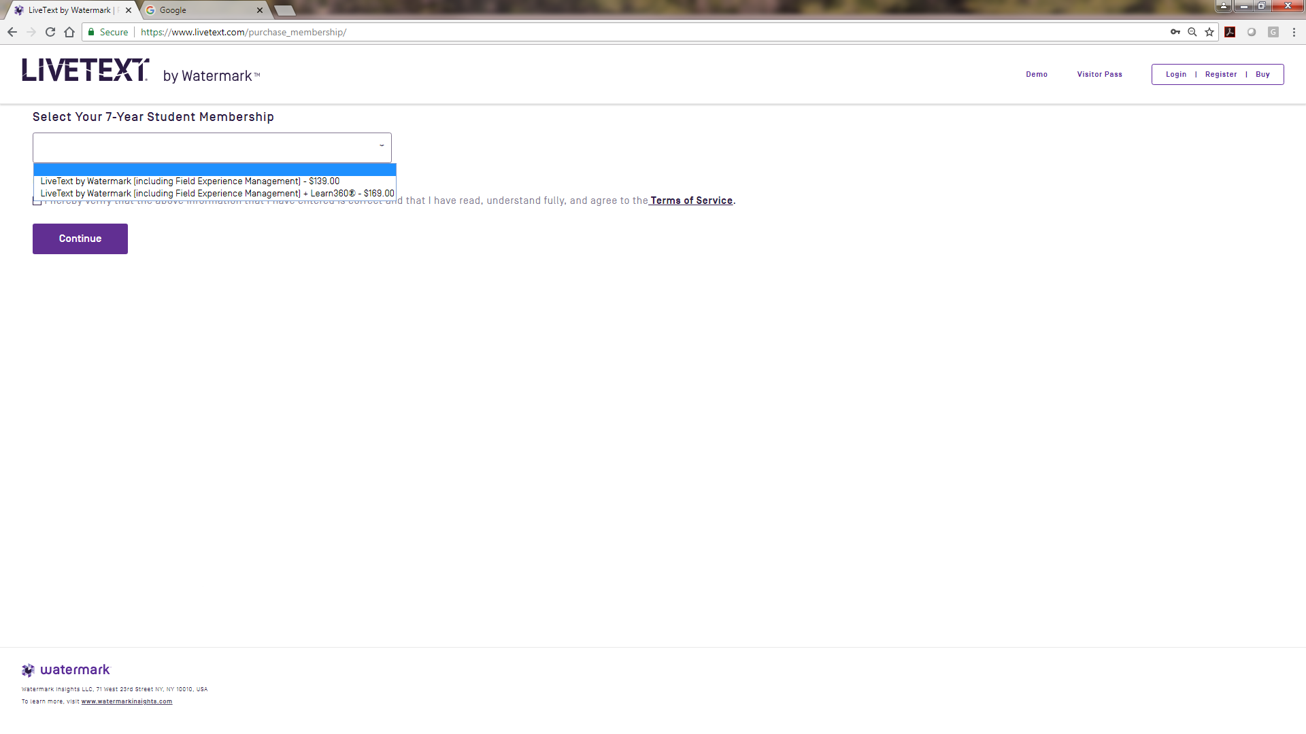
Select – LiveText by Watermark [including Field Experience Management]

Slide 6
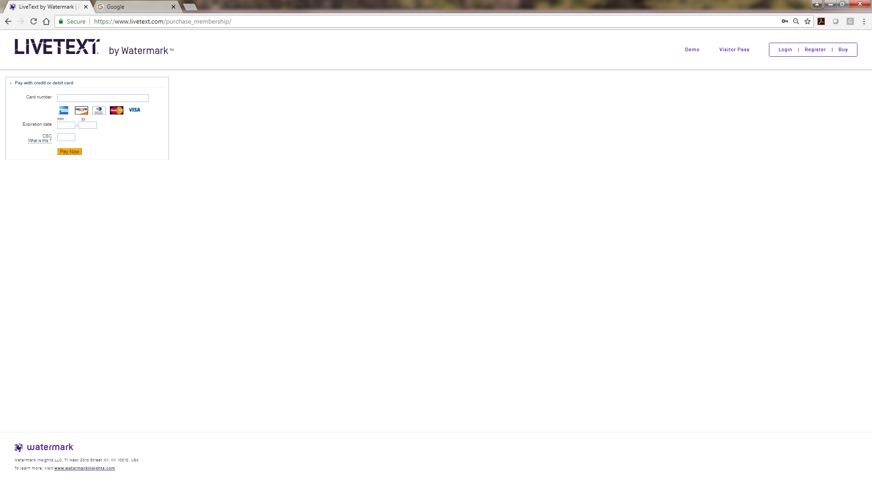
Fill in your payment information

Slide 7
CONGRATULATIONS!!!
You should be able to login and see your courses.
If you have created an account, logged in, and do not see your courses, please contact Jennifer Cason at jcason@fmarion.edu. When emailing, please include:
  Your Name and student ID number
  Your LT UN & Password
  The education courses you are registered for this semester

